Slide 1
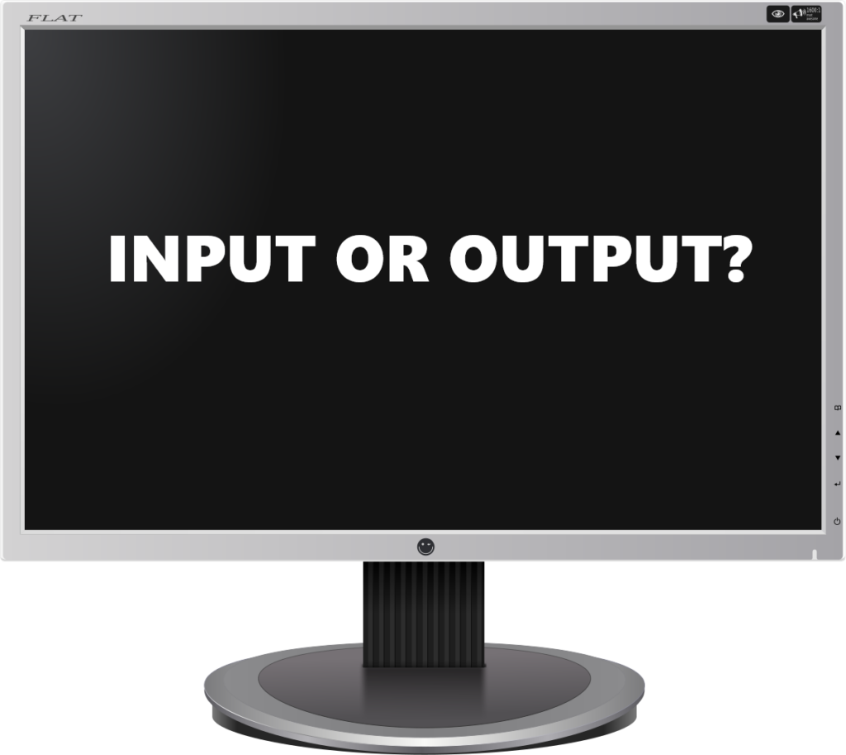

>> Tell me something, and I will repeat it back to you:
Fig. 7.1 Input() function waiting for a user input

Slide 2
>> Tell me something, and I will repeat it back to you:
Hello everyone!
Fig. 7.1 Input() function waiting for a user input

Slide 3
>> Tell me something, and I will repeat it back to you:
Hello everyone!
>> Hello everyone!
Fig. 7.1 Input() function waiting for a user input

